Slide 1
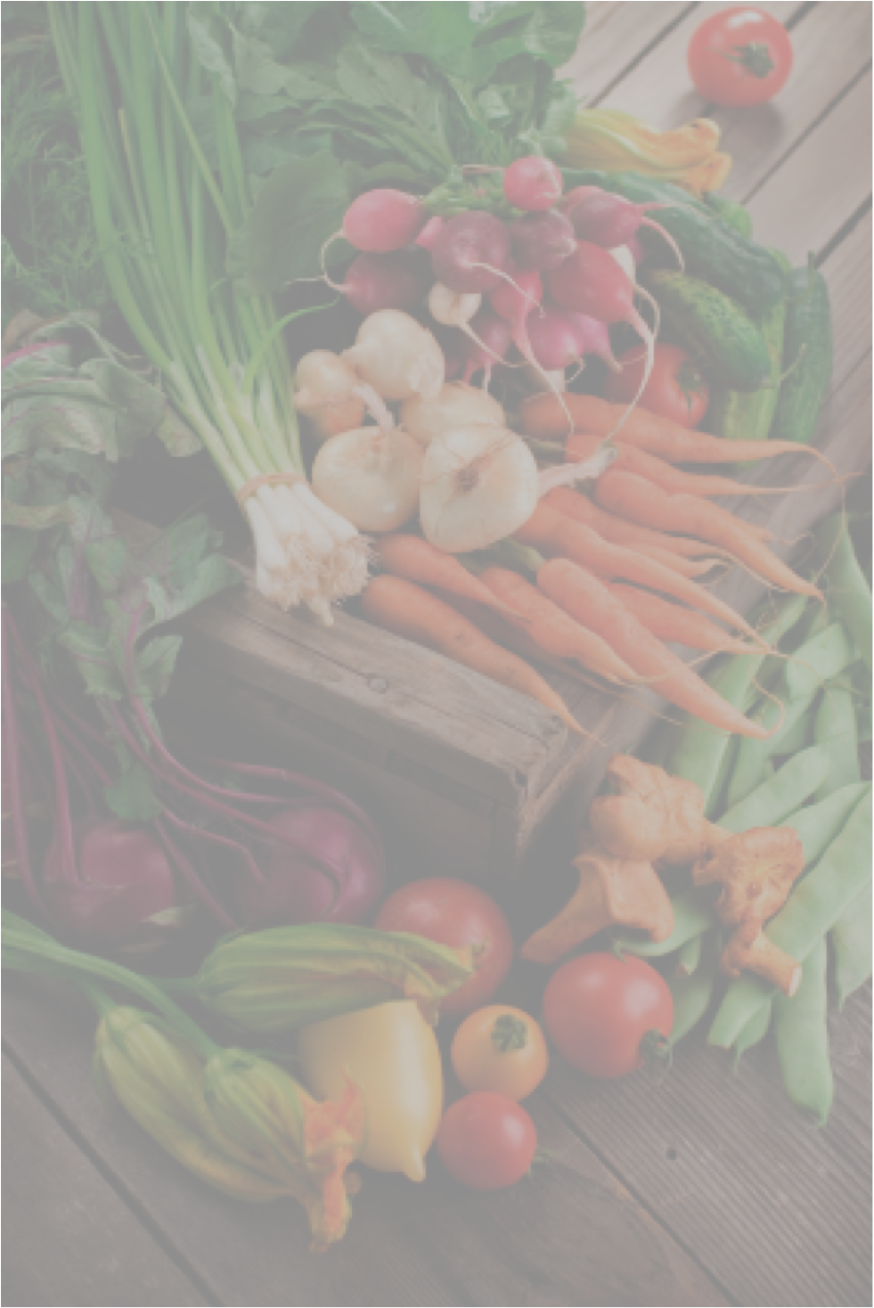
_
What can Healthy Cooking do for you?
Lose weight
Feel more energetic
Prevent or manage diabetes, high blood pressure and high cholesterol
Make healthy foods taste good
Sign up for free Culinary Medicine classes.
Washington University medical students share science and cooking tips behind healthy eating. Classes runs Sept 20 - Oct 18 every Thursday from 6-8 pm for 5 weeks at Sportsman’s Park Boys and Girls Club. Dinner is included!
We encourage families, parents, young adults or anyone making decisions regarding food to participate.
Sign up at the front desk or call or text (314)669-6805 and leave:
First and last name
Number of people interested
Phone number and/or email.
The first 20 families to call will have a spot in the class.

